Slide 1
True Storytelling of Peak Water in New Mexico
David M. Boje
October 10 2018

Slide 2
Truestorytelling.org

Slide 3
1st True Storytelling Principle: You yourself must be true and prepare the energy and effort for a sustainable future
Water is life, and our body is 75% water as infant, and 65% as adult male and 60% as adult female? Why do women have less water than men? Men usually have more body fat.
In 37.2 living cells is 2/3rds of the water in our body, and other 1/3 of living water is extracellular. Our body is colonies of trillions of living cells, 2/3rds water, swimming in the other 1/3rd of the living water lubricating our joints, digesting food, wetting the eyes, nose, and throat
Our brain cells are 73% water, lungs 83%, muscles & kidney 71%, skin 64%, and bones 31% water.
To prepare the energy of your body for a sustainable future, drink plenty of water, to stay alive in the desert.
Story of David’s microscope water experiments

Slide 4
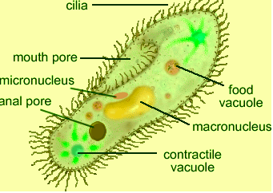
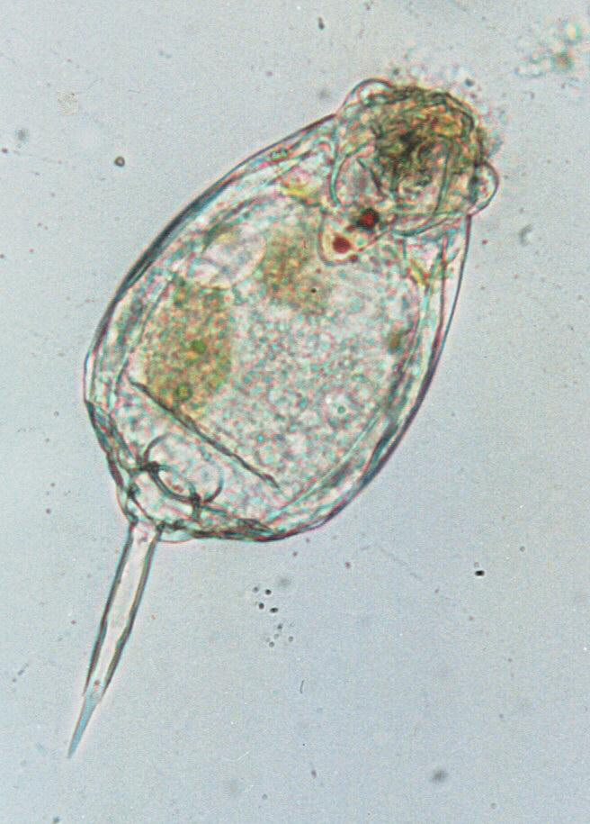
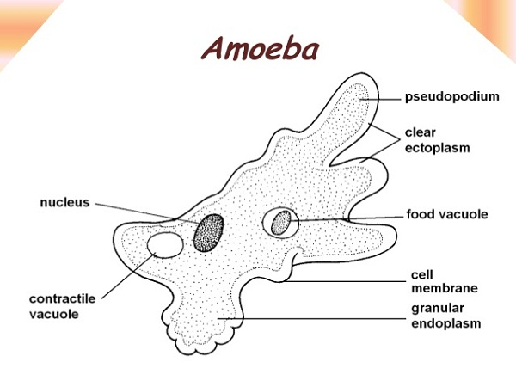
What I saw living in Water
Paramecium
Protozoa

Slide 5
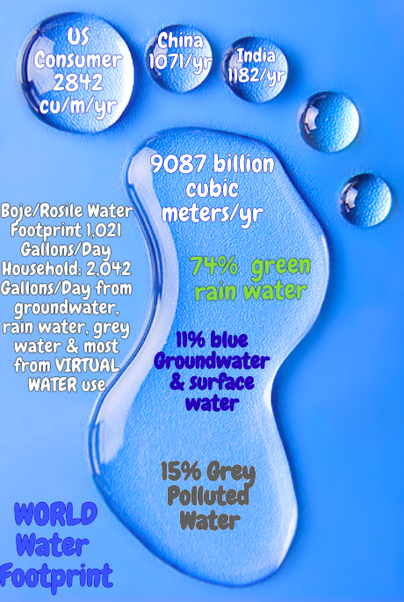
US Consumer uses 2842 Cubic Meters per year is equivalent to 751,041 Fluid Gallons, which is double any other nation.
That includes what your drink, use for bathing, etc. but also includes the Virtual Water use, such as, what water is required to make every thing we consume that capitalism produces
1 Cubic Meter = 264.172052 Gallons [Fluid, US]
Figure by BOJE
Notes:
The total volume of international virtual water flows related to trade in agricultural and industrial products was 2,320 Gm3/y (68% green, 13% blue, 19% gray). The WF of the global average consumer was 1,385 m3/y. The average consumer in the United States has a WF of 2,842 m3/y, whereas the average citizens in China and India have WFs of 1,071 and 1,089 m3/y, respectively.

Slide 6
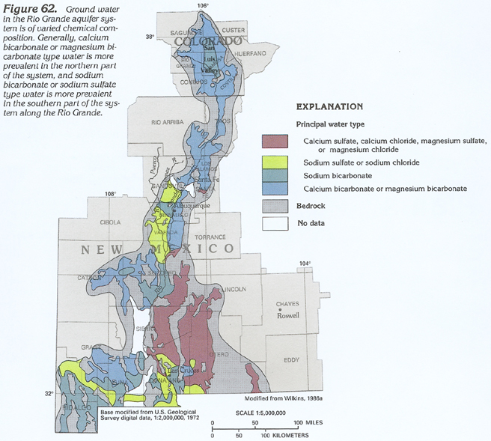
https://pubs.usgs.gov/ha/ha730/ch_c/jpeg/C062.jpeg

Slide 7
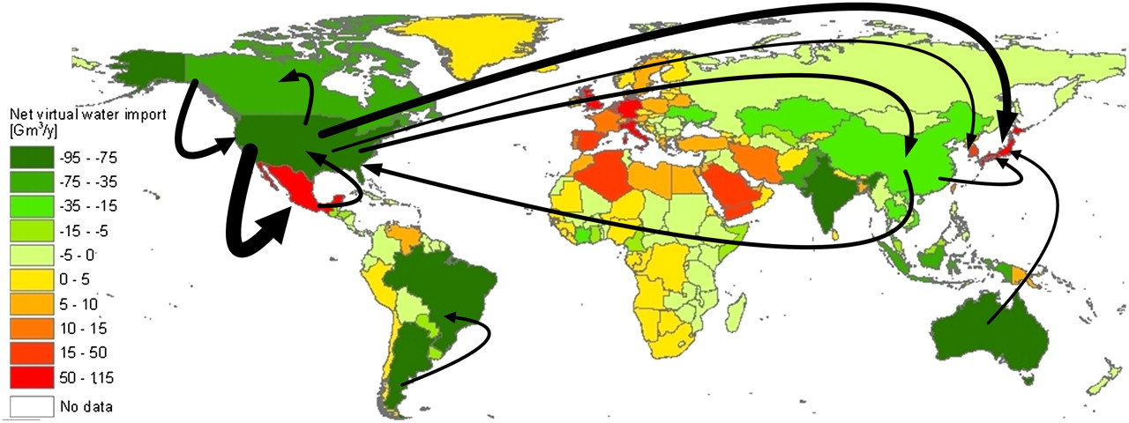
Virtual water balance per country and direction of gross virtual water flows related to trade in agricultural and industrial products over the period 1996–2005.
Arjen Y. Hoekstra, and Mesfin M. Mekonnen PNAS 2012;109:9:3232-3237
©2012 by National Academy of Sciences
Notes:
Virtual water balance per country and direction of gross virtual water flows related to trade in agricultural and industrial products over the period 1996–2005. Only the biggest gross flows (> 15 Gm3/y) are shown.

Slide 8
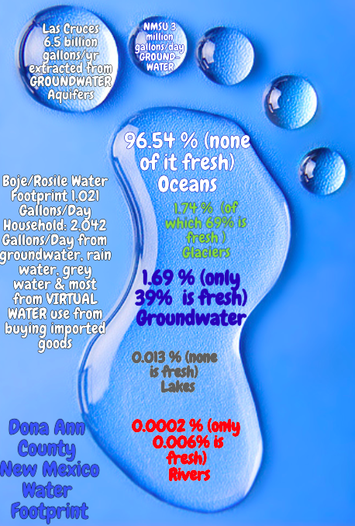
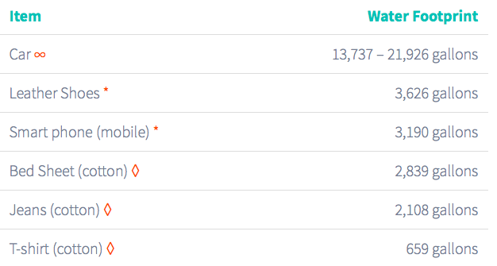
https://www.watercalculator.org/wfc2/ to Calculate your own water footprint
Figure by BOJE
Notes:
https://water.usgs.gov/edu/gallery/global-water-volume.html
25% of water wasted is associated with food discarded

Slide 9
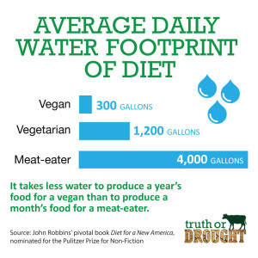
Boje/Rosile have vegan diet, electric by photovoltaic, have rain water barrels and do composting. Boje’s blacksmith shop if straw bale; house itself is solar designed

Slide 10
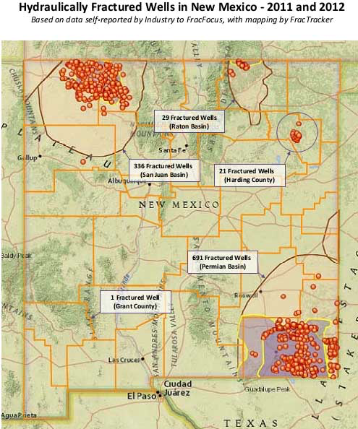
It takes 4.5 million gallons of Water to drill and fracture a typical deep shale gas Well (source); other sources say it takes 300 million gallons for each well fracking
As of March 2, 2017, there were 29,996 approved oil wells and 27,780 approved natural gas wells in New Mexico. As of this date, however, the state did not track the number of wells that were hydraulically fractured. The map below shows the location of oil and gas production in the state.
Steve Pearce, Republican, is running for governor against Lujan Grisham, Democrat. They differ on their approach to Fracking. Pearce says his opponents approach to fracking will drive fracking into Texas and rob the education budget of millions. Grisham says she does not advocate increasing the fracking footprint, and adds “the notion that oil and gas can’t survive when you also do renewable is false… In fact, it’s ludicrous.”
The water footprint of humanity Arjen Y. Hoekstra and Mesfin M. Mekonnen
Notes:
https://libraryguides.law.pace.edu/c.php?g=319403&p=6095188

Slide 11
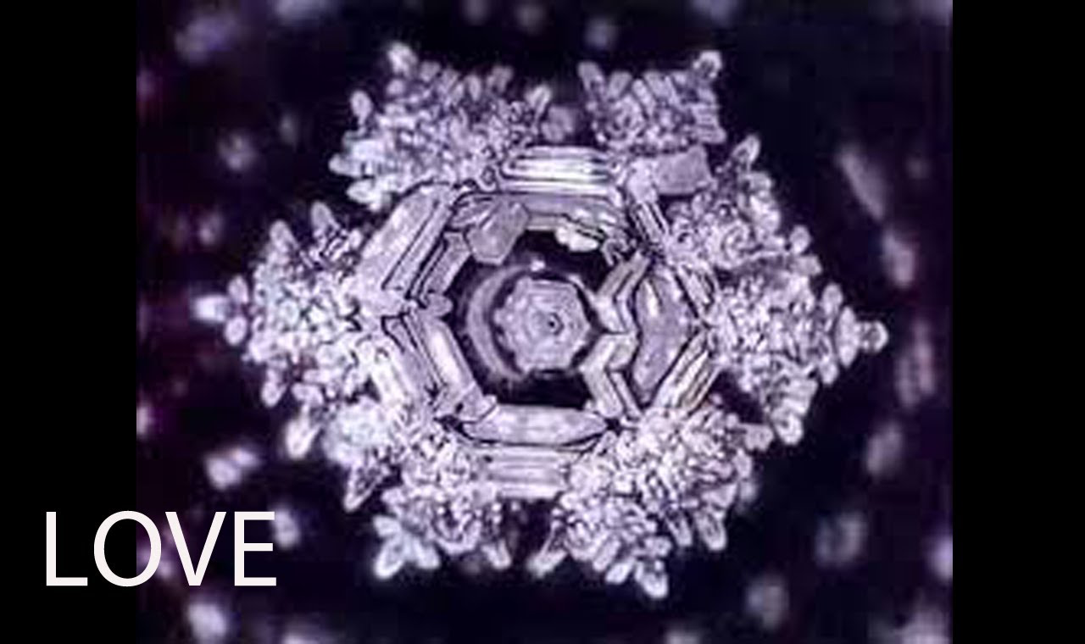
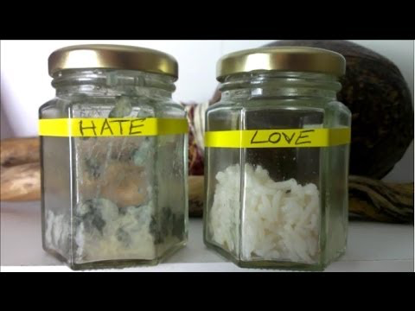
2nd True Storytelling Principles: True storytelling makes spaces respecting the stories already there
Dr. Masaru Emote water experiments; Water is life vibratory frequency
If we speak love to water, it has beautiful crystal structuring
If we speak hate to water, it has some chaotic patterns
Rice Consciousness experiment and what is said to it
Boje’s story of Nahdion not drinking water and spirit of life of shamanic healing
What are the story spaces already here and now? E.g Mora County declares Water natural rights against oil & gas extraction & against fracking

Slide 12
True Storytelling of Mora County
Like New Zealand, Mora has granted water & natural resources “inalienable and fundamental rights to exist and flourish… against oil and gas extraction” & fracking ➔ due to negative externalities (pollution of water, air, noise (truck traffic), & light pollution). https://digitalrepository.unm.edu/nrj/vol54/iss2/4/

Slide 13
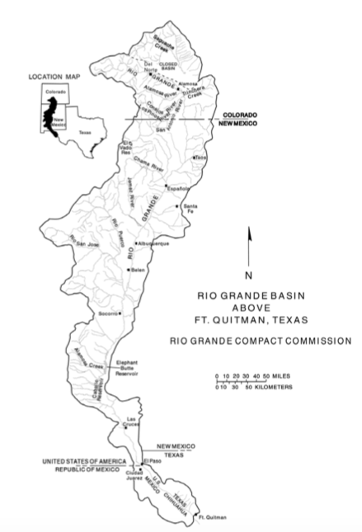
Rio Grande Compact
Signed 1938 in United States between states of Colorado, New Mexico, and Texas, and approved by Congress, to equitably apportion the waters of the Rio Grande Basin
1939-1966, Colorado ignored the compact
1966, due to Colorado's non-compliance with the Compact, Colorado owed New Mexico one-million acre feet (1.2 km³) of water, and New Mexico owed Texas 500,000 acre feet (620,000,000 m³).
New Mexico and Texas collectively sued Colorado to try to force compliance, and between 1966–1967, the case progressed and was eventually heard by the Supreme Court of the United States
USGS continuing to develop model of the transboundary aquifers and interconnected surface waters of the Palomas and Mesilla Basins in New Mexico and Texas and the Conejos-Médanos Basin of northern Mexico.
Last known reports:http://www.ose.state.nm.us/Compacts/RioGrande/Tables/RGCompact_Co_Deliveries_2008.pdf and http://www.ose.state.nm.us/Compacts/RioGrande/RGCC%20Reports/RGCC%202017.pdf

Slide 14
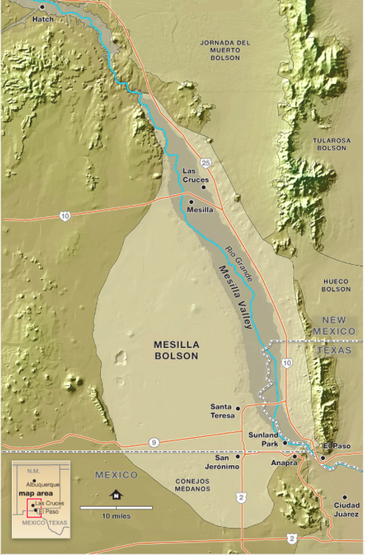
3rd True Storytelling Principle: You must create stories with a clear plot creating direction and help people prioritize
Las Cruces and NMSU extract living water from the Mesilla, Jornada Del Muerto (means journey of the dead man), and Tularosa boson aquifers with population 329K
Aquifers in New Mexico are being extracted faster than they replenished due to overuse & climate change; The recorded number of water wells for livestock use in the State Engineers Office for southern New Mexico is 1763 (Seawolf et al.2015).
El Paso’s Hueco aquifer is running out, so they have desalinization plant, introduced water conservation to have sustainable future.
NMSU, by contrast is pumping 3 million gallons a day, and Las Cruces must is maxed out in Rio Grande Compact
YOU ARE HERE ➔

Slide 15
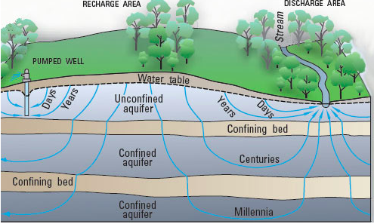

Slide 16
New Mexico Aquifers Water Levels declining, and water quality deteriorating
This is especially the case for agricultural, industrial, and metropolitan aquifer users
My concern is the long-term aquifer sustainability for groundwater pumped by New Mexico State University, Las Cruces, and Dona Ana County.
Salinity is increasing as are contaminants entering aquifer water banks.

Slide 17
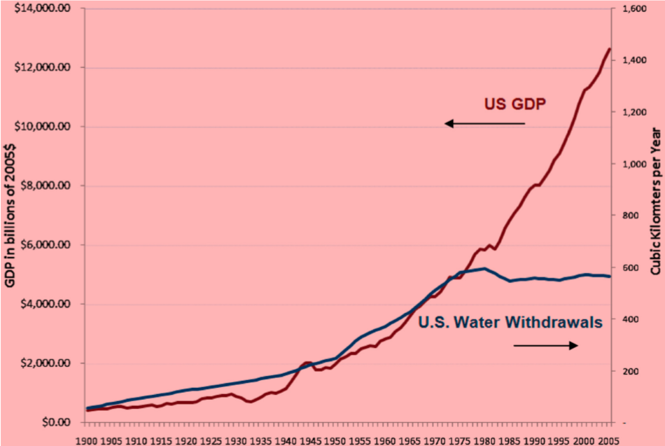
4th True Storytelling Principle: You must have timing
PEAK
WATER
LIMIT
1980, US passed “Peak water limits to freshwater withdrawal and use (Peter H. Gleick1 and Meena Palaniappan). Therefore the timing to have sustainable aquifers is now critical; Time to stop treating GDP growth as measure of water use because ‘water is life’ for all species

Slide 18
Las Cruces Aquifers
Las Cruces Utilities Water Section produces approximately 6.5 billion gallons of clean, safe drinking water annually
It pumps its water from two deep aquifers;
the Mesilla and Jornada Bolsons.
This section maintains 30 wells, 13 storage tanks, 10 booster stations, 30 regulating valves, and more than 600 miles of underground water lines http://www.las-cruces.org/en/departments/utilities/water

Slide 19
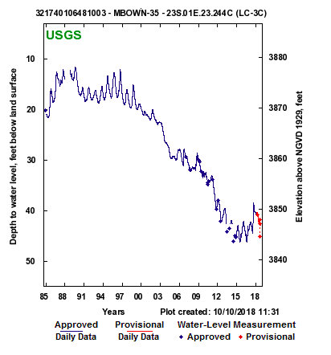
A Well In Las Cruces, NM

Slide 20
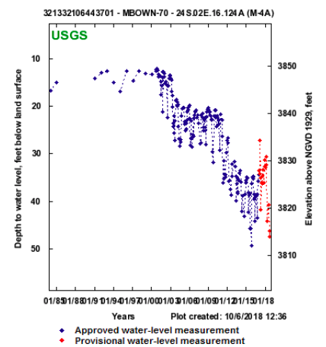
Another Well of Las Cruces

Slide 21
NMSU uses 3 million gallons of water a day, and 1 million is for golf
NMSU is overpumping its aquifers for golf greens and watering trees that belong in Iowa; The Rio Grande River is being used for humancentric uses.
There is no water conservation at NMSU since it would interfere with the allotment from the 1938 ‘Rio Grande Compact Agreement’ of Colorado, NM, Texas and bi-nation agreement with Mexico in 1946.
“From its Colorado headwaters to the Gulf of Mexico, the Rio Grande is habitat for a plethora of animal and plant species, including migratory birds arriving from far to the north for winter refuge … Yet the river’s current order of importance in the bilateral relationship between the US and Mexico is far down the list of mutual priorities, upstaged by the so-called narco war, immigration, oil politics and issues of national security. That’s the assessment of a Mexican doctoral student who’s spent the fall semester in residence at the Department of Geography of New Mexico State University (NMSU)”
Problem: NMSU still using the water as if its still 1938 conditions before climate change

Slide 22
Groundwater in Unconfined New Mexican Aquifers Alex Rinehart
Overall, groundwater storage in unconfined aquifers is declining in populated regions, especially in areas isolated from perennial rivers. Areas without intensive irrigated agriculture or major population centers have shown smaller decreases or remained roughly static.

Slide 23
LEADERSHIP IN WATER New Mexico spent the last decade gradually strengthening its rules for major polluters. But since taking power in 2011, Republican Gov. Susana Martinez's administration has aggressively attacked environmental protections. The copper rule is the latest reform, and potentially the most damaging. Water-quality advocates fear it will set a precedent for all polluters, from drycleaners to molybdenum mines. As Olson puts it: "It's probably the biggest thing to happen with groundwater protection in New Mexico since the rules were first adopted 35 years ago
New Mexico has defunded doing water level measurement of its aquifer well depths.
New Mexico is violating the True Storytelling Principles
No preparing for a sustainable future
Not making spaces respecting the story already there in its aquifers
Lack of timing, since NM and US are past the Peak Water Limit, and now the remaining water gets more expensive
"The Martinez administration has moved out anyone who is effective or who had knowledge or skill in geology and hydrology," says Bruce Frederick, a trained hydrologist and an attorney with the New Mexico Environmental Law Center, which is fighting the copper rule and other regulatory rollbacks. "The idea is to make the Environment Department ineffective."

Slide 24
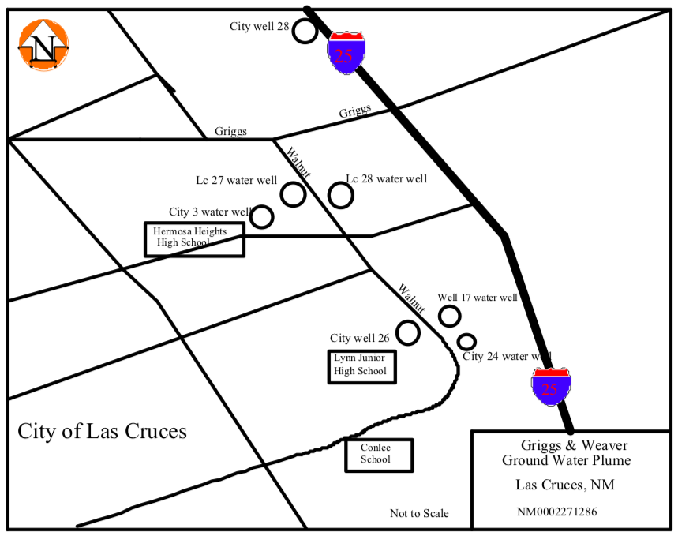
The Safe Drinking Water Act Maximum Contaminant Level (MCL) is exceeded in 2005 in one municipal supply well and 14 monitor wells. The exact extent of the plume has not yet been defined but is estimated to be 1.5 miles by 1 1/2 miles and lies within the central district of the City. source

Slide 25
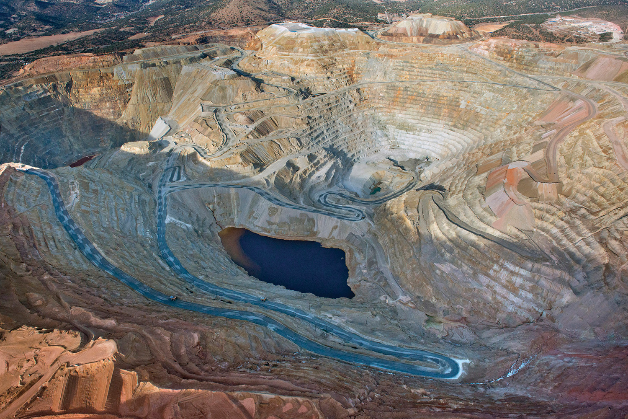
The Copper Threat to New Mexico Groundwater

Slide 26
New Mexico fight over Manure Water Lagoons
THE COW-Water RULE -… monitoring wells to quickly detect leaks, and synthetic liners to keep nitrates, and salts, from seeping into groundwater from manure lagoons. The dairies boycotted the rule's initial advisory group process, balking at the regulatory expense and oversight, and threatening to take their 4,000 jobs elsewhere
In sum, THE TIMING IS NOW!

Slide 27
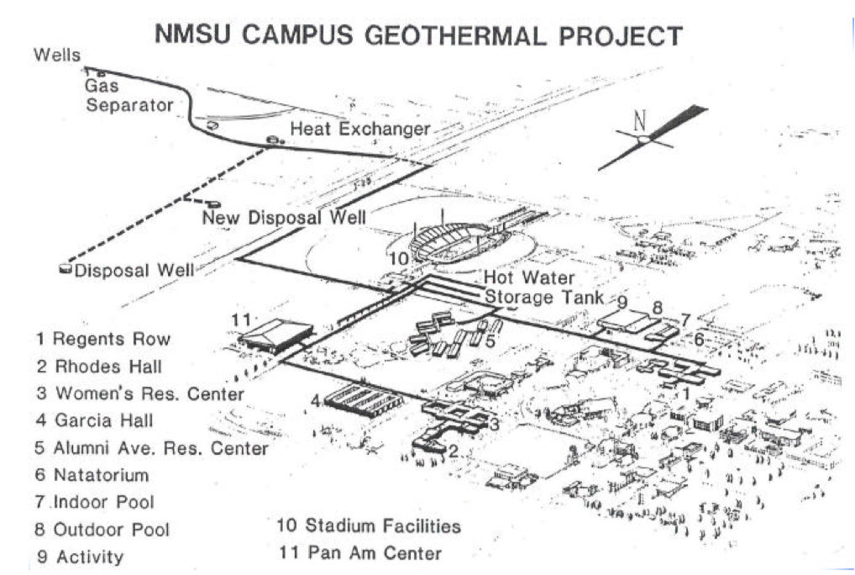
5th True Storytelling Principle” You must be able to help stories on their way and be open to experiment
Once upon a time, NMSU was helping a sustainable living water story along.

Slide 28
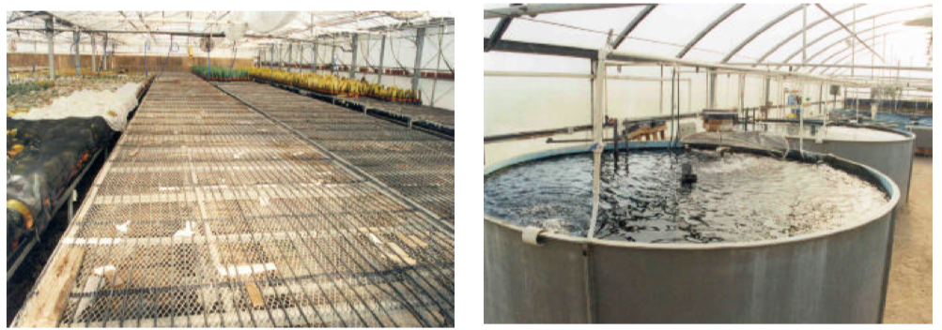
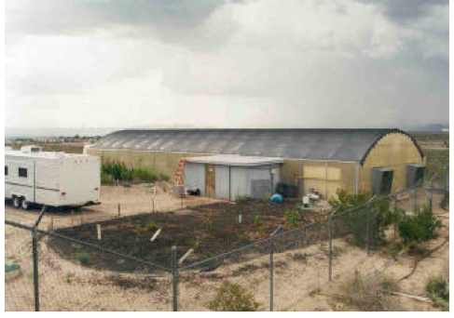

Slide 29
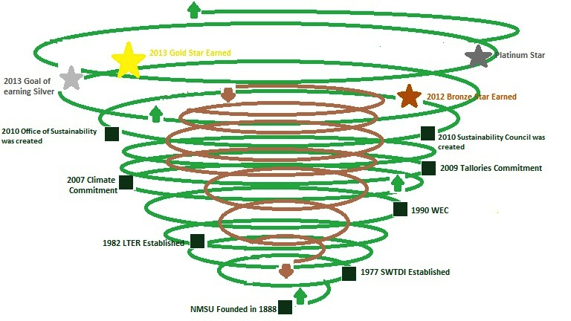
I participating in #5 Principle – Helping a School of sustainability along the way, experimenting

Slide 30
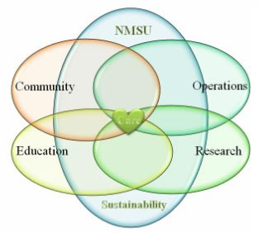
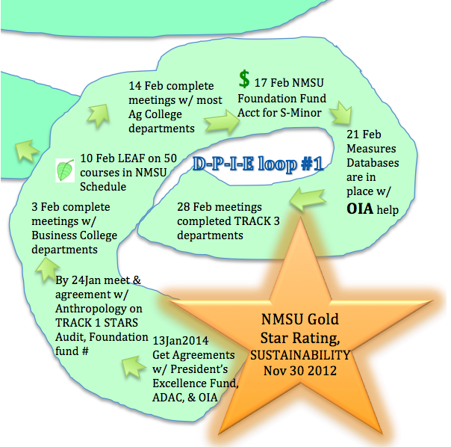
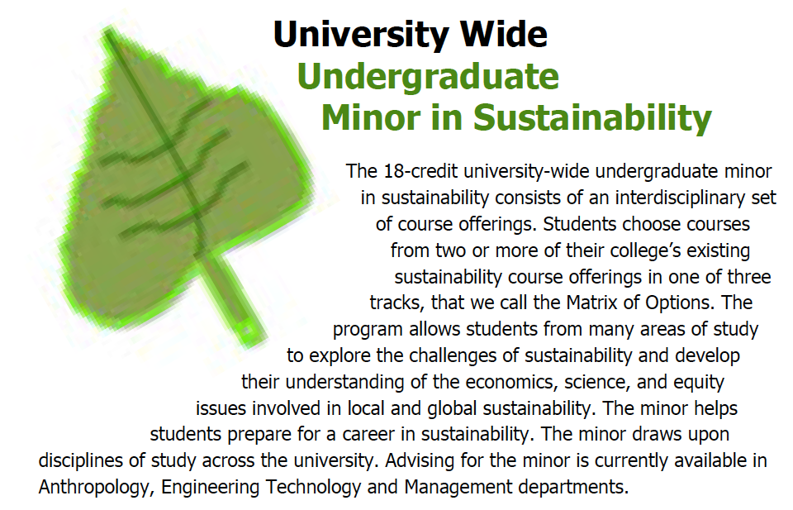
#5 Help Story on their way: When I asked Jeff to step down from Faculty senate, so I could run for the seat, and develop a School of Sustainability Initiative

Slide 31
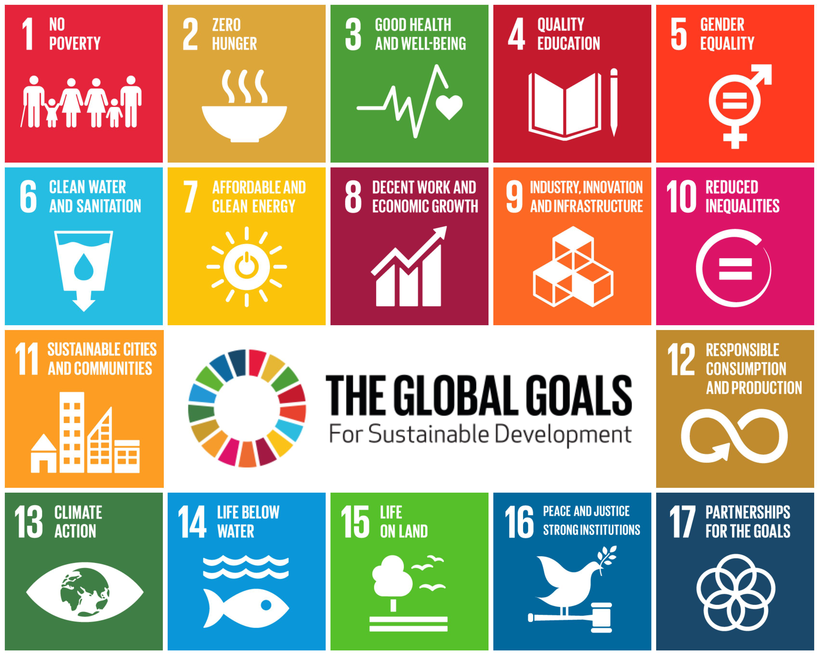
6th Principle: You must consider staging including scenography and artifacts
Staging the new story with the ‘refillable water bottle’ artifact. Scenography of the Popup Events of 17 UN Sustainable Development Goals.

Slide 32
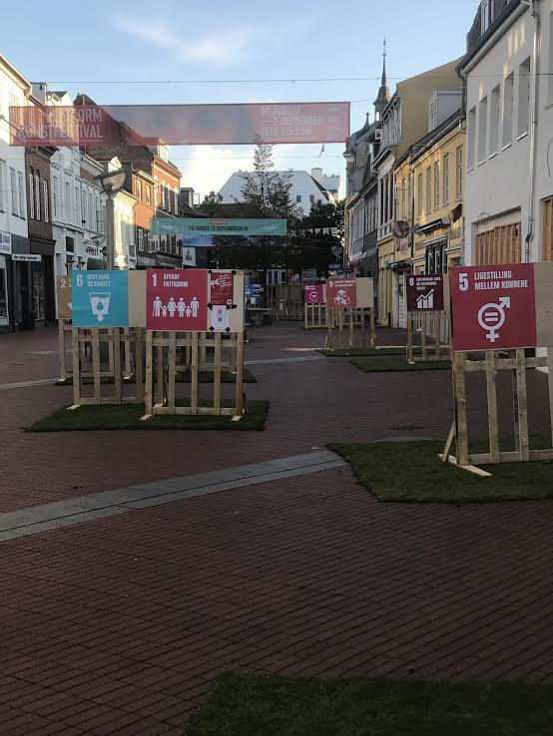
Kolding Denmark’s Popup of 17 UN Sustainable Development Goals August 25-26 2018

Slide 33
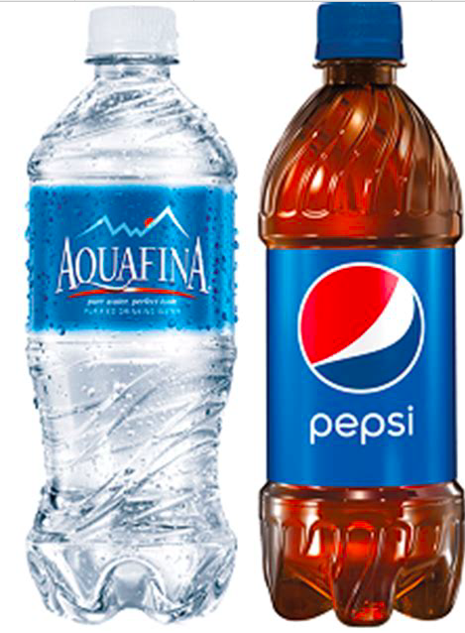
7th Principle: You must reflect on the stories and how they create value
A post-Carboniferous Capitalism will do away with single-use plastic production & consumption
Aquafina & Pepsi contracts at NMSU are a waste of water, and a very unhealthy higher education
Fecal matter) found in Nestle Pure Life and Baraka Water bottled water and live protozoa in samples of Aquafina bottled water, produced by PepsiCo,“unfit for human consumption.” Bottled Water in Egypt Aquafina & Pepsi bottled water has twice the microplastic than tap water used to make it. Pepsi admits Aquafina is just tap water.

Slide 34
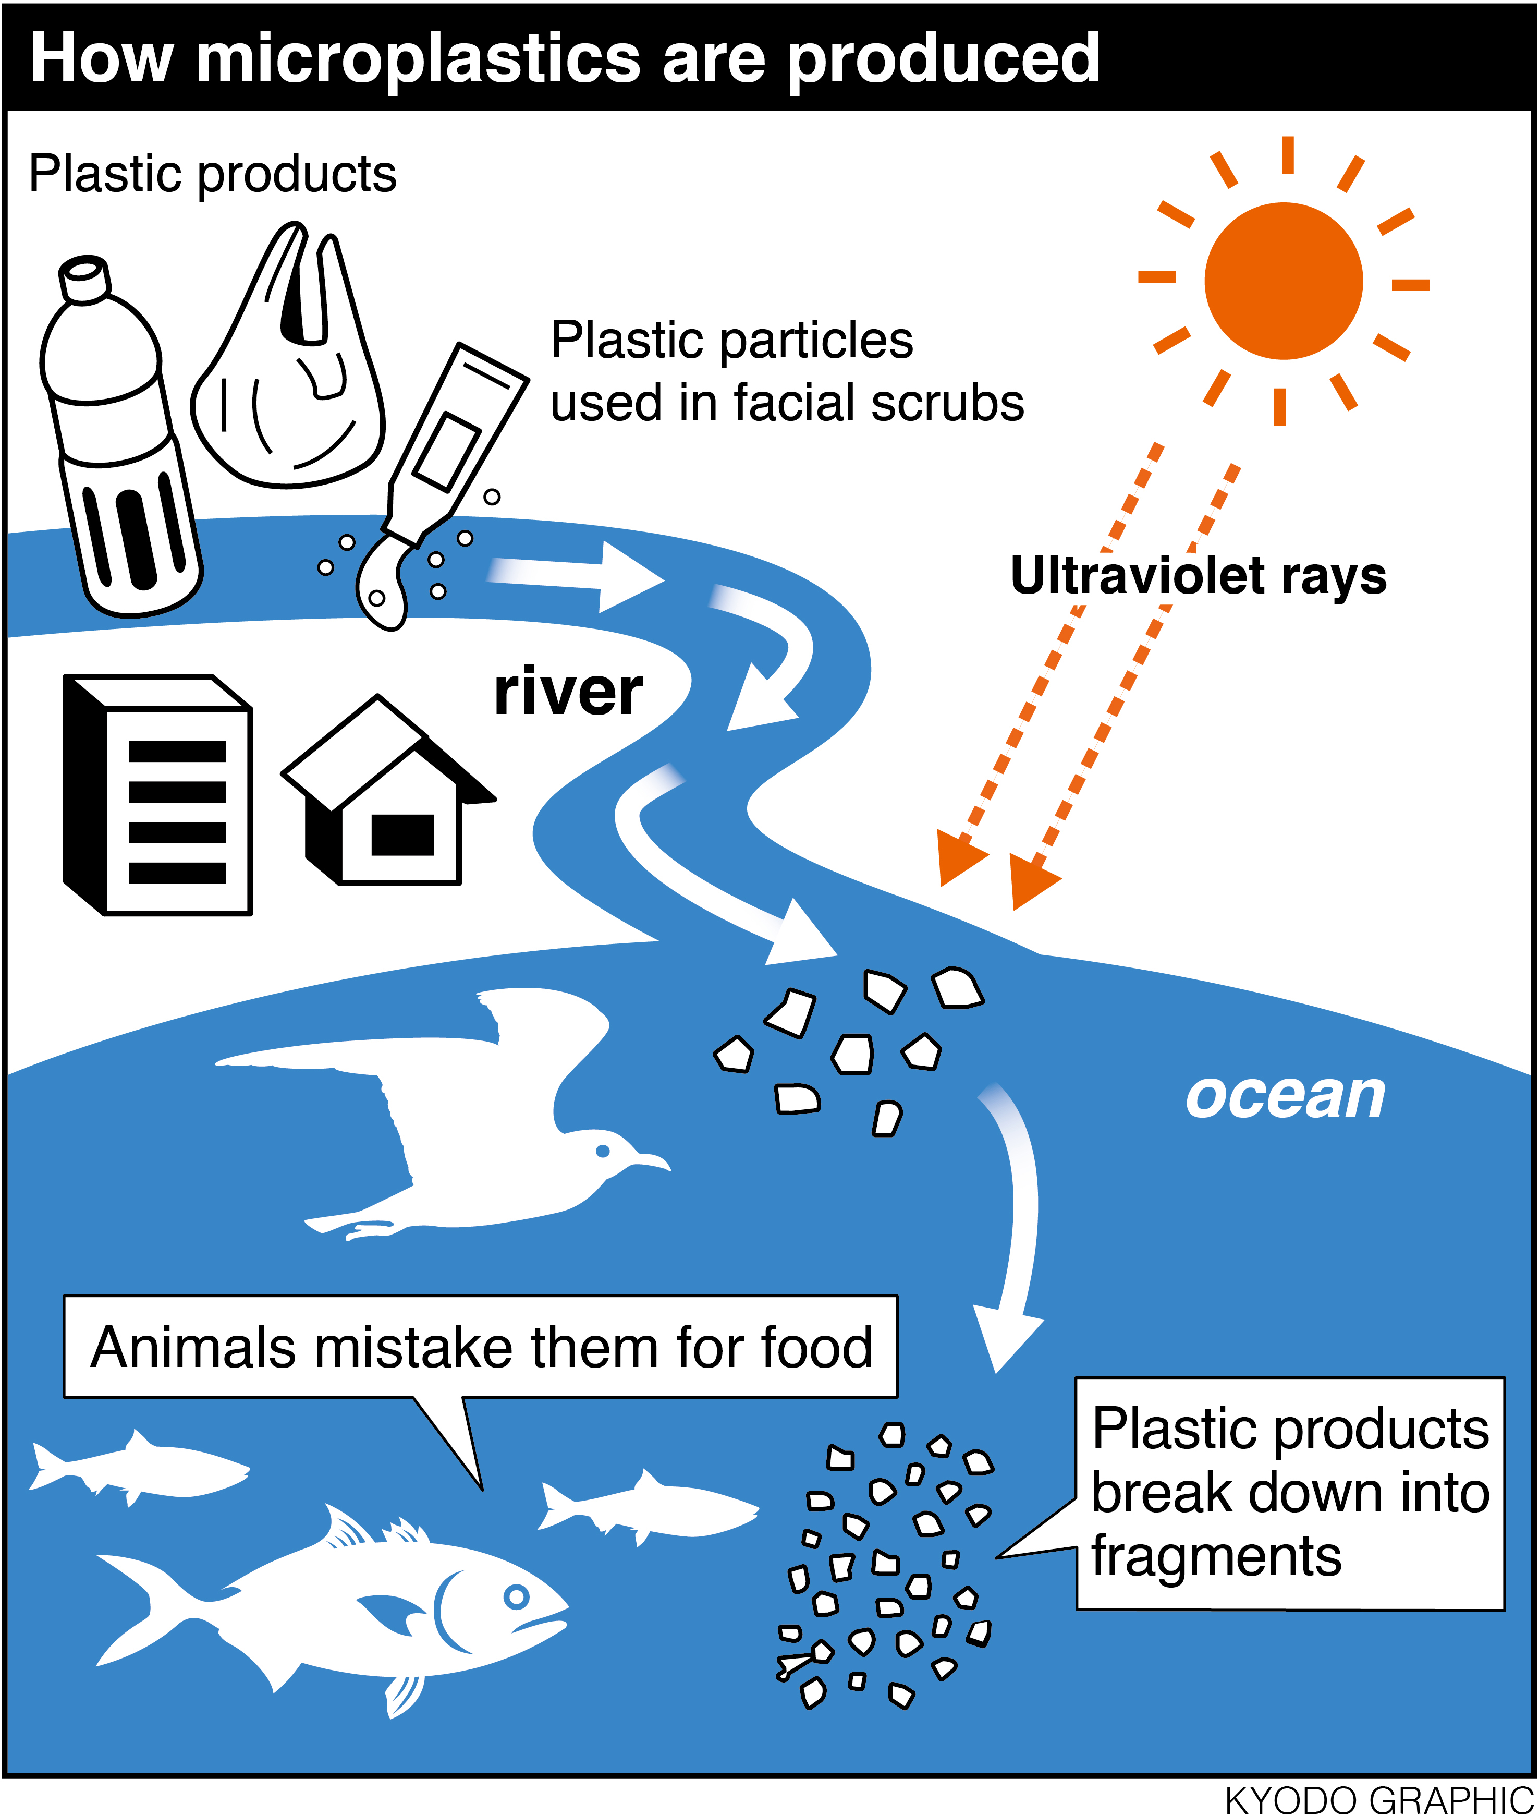

Slide 35
The Materialism of Coca Cola & Peak Water Crisis
Ecofeminist, Dr. Vandana Shiva: “if you look at a Coca Cola bottle it always says produced by Coca Cola, and they are not meaning the plastic, they are meaning the water inside. All they have done is steal the water from somewhere.” http://podacademy.org/podcasts/ecofeminism/
Coca Cola admits Dasani is tap water
As population rises, overpumping means some nations have reached peak water, which threatens food supply, says Lester Brown (source)

Slide 36
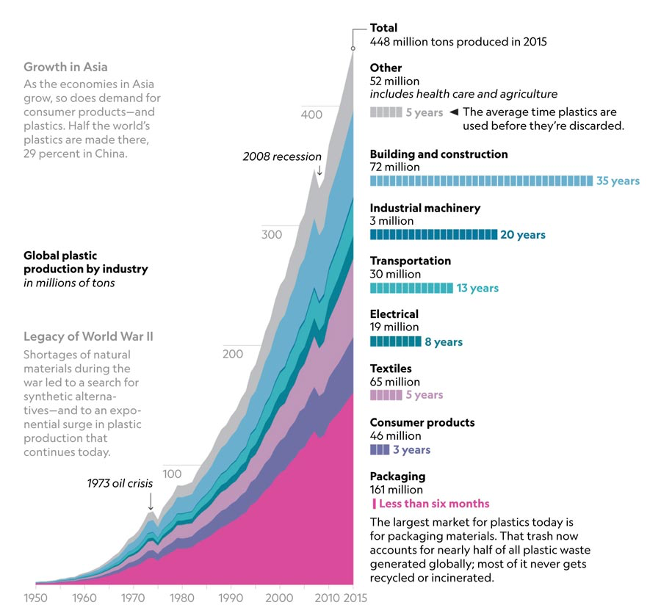

Slide 37
Presence of Pharmaceutical Compounds in Water, North Central New Mexico Patrick Longmire, Ph.D.
Endocrine disruptor chemicals (EDC) and pharmaceutical and personal care products (PPCP) are contaminants of significant concern found in aquatic environments worldwide. Numerous hydrophilic EDC and PPCP have been measured in treated and non-treated wastewater, surface water, and groundwater throughout the United States and Europe during the past several decades.…along the Rio Grande and Santa Fe River are routinely analyzed for 32 PPCP using EPA method 1694. Analytical results show variable types and concentrations of PPCP present at most sampling locations. These water-soluble chemicals undergo limited adsorption/partitioning onto mineral surfaces and solid organic matter and typically migrate in groundwater without any retardation. Commonly detected PPCP present in treated wastewater include acetaminophen, caffeine, carbamazepine, DEET, diazepam, diclofenac, dilantin, fluorextine, gemfibrozil, hydrocodone, meprobamate, methadone, salicylic acid, and sulfamethoxazole

Slide 38
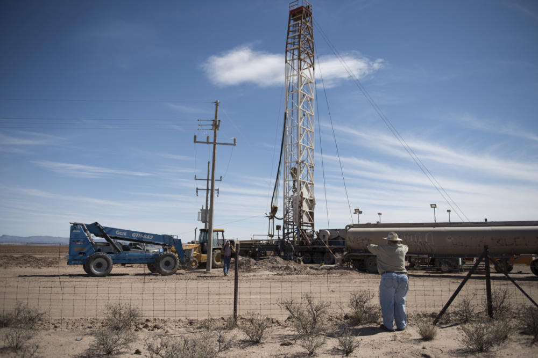
Along the Texas/New Mexico border, drilling into aquifer water

Slide 39
On the US/Mexico Water Border
Mexican officials report that wells drilled to a depth of about 400 feet are drying up or producing poor quality water, forcing users to contemplate drilling new wells of depths of 750 feet or more… the level of aquifer is going down and some wells are beginning to be exhausted
https://fnsnews.nmsu.edu/border-wells-drying-up/

Slide 40
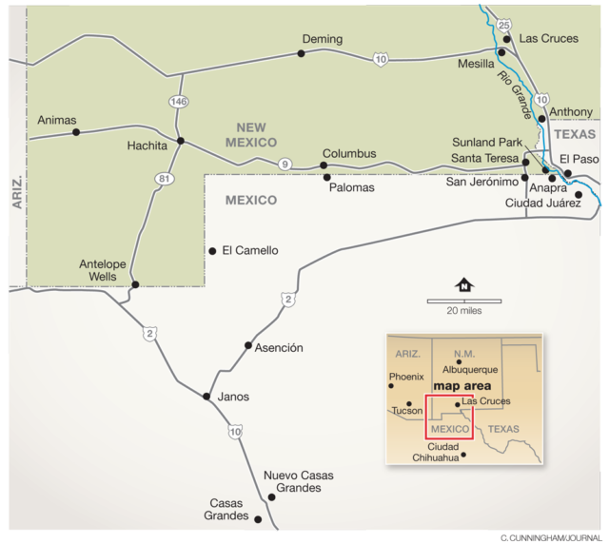
“The closer to NM/Mexico border, the deeper you have to go (1,500 feet) to reach water, “About 5 kilometers (3 miles) in, the water is closer to the surface” source

Slide 41
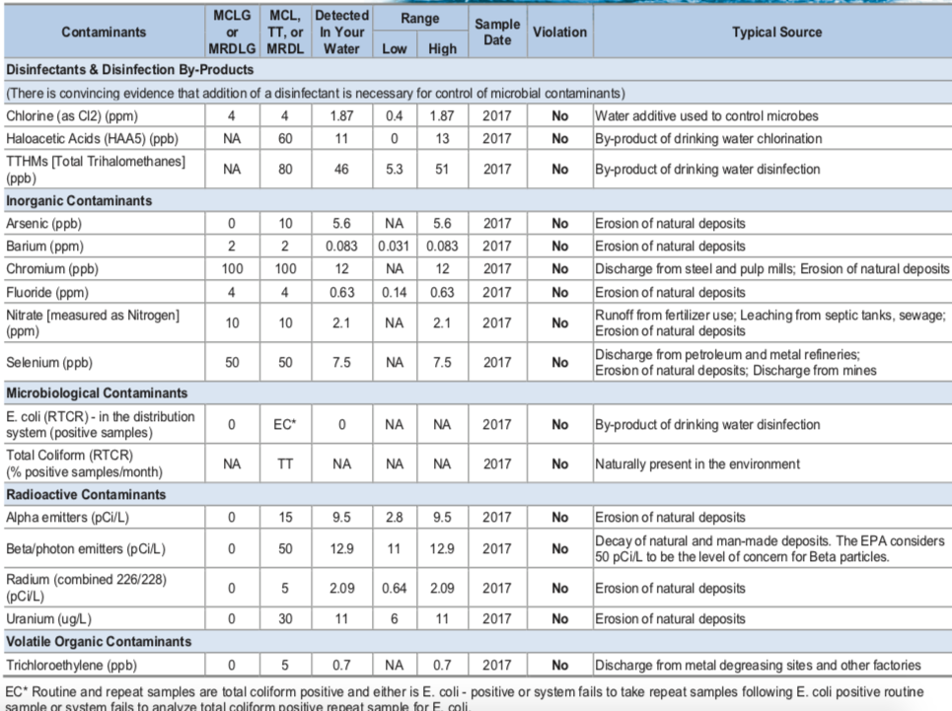
LAS CRUCES

Slide 42
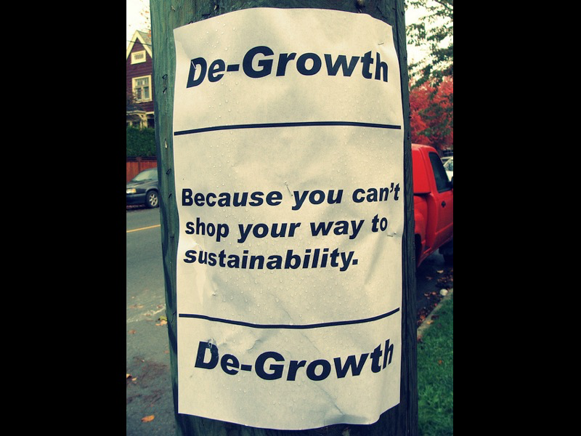
We are already
de-growing our water supply
Growth for Water Scenarios are Unrealistic because EROI is decreasing each year
It costs more to get the next water than the energy it generates, but that is life
Schumacher (1973) SMALL IS BEAUTIFUL
SIMPLIFY
MINIMALIZE
RETHINKING GROWTH YOUTUBE
https://www.youtube.com/watch?time_continue=264&v=0MXP2E09dJQ
More at http://rethinkingprosperity.org/solutions-degrowth/

Slide 43
Question & Answers about TRUE STORYTELLING
Thank you and Come to the December Conference
Slides & books at www.truestorytelling.org
Conference https://davidboje.com/quantum

